Slide 1
Ecology Meets Epidemiology
E²M²: Ecological and Epidemiological Modeling in Madagascar
Centre ValBio
Ranomafana National Park, Madagascar
6 – 14 January, 2020

Slide 2


Thanks to our sponsors!
Lecture contributions from:
Tanjona Ramiadantso
Steve Bellan

Slide 3

International Clinics on Infectious Disease, Dynamics, & Data

Slide 4
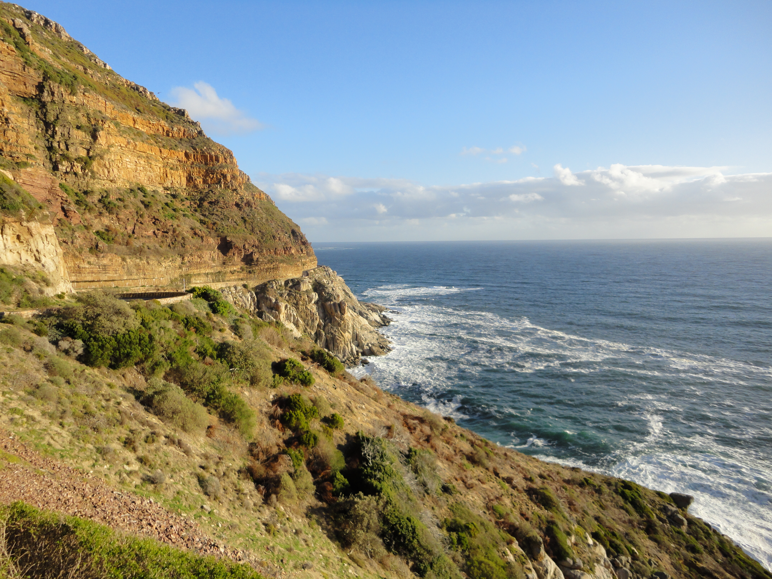
International Clinics on Infectious Disease, Dynamics, & Data
MMED: Clinic on the Meaningful Modeling of Epidemiological Data
May-June 2019, Cape Town, South Africa

Slide 5
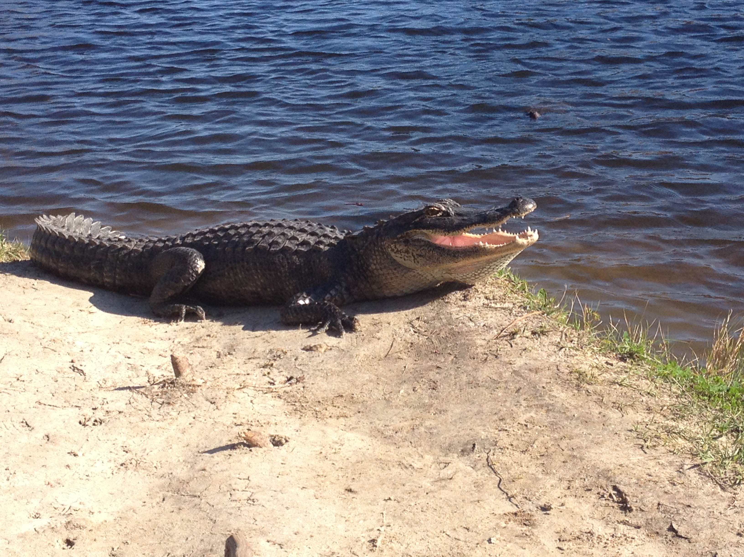
International Clinics on Infectious Disease, Dynamics, & Data
MMED: Clinic on the Meaningful Modeling of Epidemiological Data
May-June 2019, Cape Town, South Africa
DAIDD: Clinic on Dynamical Approaches to Infectious Disease Data
December 2019, Florida, USA

Slide 6
International Clinics on Infectious Disease, Dynamics, & Data
MMED: Clinic on the Meaningful Modeling of Epidemiological Data
May-June 2019, Cape Town, South Africa
DAIDD: Clinic on Dynamical Approaches to Infectious Disease Data
December 2019, Florida, USA
South African Center for Epidemiological Modeling and Analysis (SACEMA), Director
Dr. Juliet Pulliam
University of Stellenbosch
ICI3D, Program Director
Dr. Steve Bellan
University of Georgia

Slide 7
International Clinics on Infectious Disease, Dynamics, & Data
www.ici3d.org

Slide 8
Goals for this lecture
To explain what we’re doing here

Slide 9
Goals for this lecture
To explain what we’re doing here
To define “science”

Slide 10
Goals for this lecture
To explain what we’re doing here
To define “science”
To define “data”

Slide 11
Goals for this lecture
To explain what we’re doing here
To define “science”
To define “data”
To define “models”

Slide 12
Goals for this lecture
To explain what we’re doing here
To define “science”
To define “data”
To define “models”
To introduce many different types of models

Slide 13
Goals for this lecture
To explain what we’re doing here
To define “science”
To define “data”
To define “models”
To introduce many different types of models
Statistical

Slide 14
Goals for this lecture
To explain what we’re doing here
To define “science”
To define “data”
To define “models”
To introduce many different types of models
Statistical
Mathematical

Slide 15
Goals for this lecture
To explain what we’re doing here
To define “science”
To define “data”
To define “models”
To introduce many different types of models
Statistical
Mathematical
To introduce the “E” in E²M²

Slide 16
Goals for this lecture
To explain what we’re doing here
To define “science”
To define “data”
To define “models”
To introduce many different types of models
Statistical
Mathematical
To introduce the “E” in E²M²
Ecology

Slide 17
Goals for this lecture
To explain what we’re doing here
To define ”science”
To define ”data”
To define “models”
To introduce many different types of models
Statistical
Mathematical
To introduce the “E” in E²M²
Ecology
Epidemiology

Slide 18
All course materials are available at:
https://carabrook.github.io/E2M2/E2M2_2019.html

Slide 19
Saturday: R Bootcamp
Intro to R Studio
Exploring and Visualizing Data in R
For-loops, Functions, and If-Else Statements
● Programming
● Data
● Models
● Research Development
Thursday: “Fitting Models to Data”
● Model Fitting in Practice – the Basic Concept
● Introduction to Occupancy Modeling
● Intro to Spatial Modeling
● Occupancy modeling in R
● Epidemic Cards
● Model Fitting with Epidemic Cards
● Model Telephone
Sunday: Travel
Friday: “Refining Your Work”
● Intro to Network Modeling
● Model Selection and Comparison
● Modeling Vector-Borne Disease
● Final research plans
Monday: “Dealing with Data”
● Data and Models
● Student introductions & presentations
● Linear regression & simple stats
● Basic statistical modeling in R
● Formulating research questions
Wednesday: “Thinking About Mechanism”
● Intro to Compartmental Models & Differential Equations
● Building mechanistic models in R
● Defining a model world
● Refining research questions for modeling
● Discussion of a scientific paper
● Mentor research presentations
Saturday: “Putting it All in Perspective”
● Modeling in Practice: The Lifecycle of a Modeling Project
● Research snapshots
Tuesday: “Deeper Thinking About Data”
● Dynamical Fever
● Intro to Mixed Modeling
● Mixed modeling in R
● Study Design and Data Collection
● Refining research questions for modeling
Sunday: Travel
Monday: “Sharing Your Work”
● Final student presentations

Slide 21
Goals for this lecture
To explain what we’re doing here
To define ”science”
To define ”data”
To define “models”
To introduce many different types of models
Statistical
Mathematical
To introduce the “E” in E²M²
Ecology
Epidemiology

Slide 22
Goals for this lecture
To explain what we’re doing here
To define ”science”
To define ”data”
To define “models”
To introduce many different types of models
Statistical
Mathematical
To introduce the “E” in E²M²
Ecology
Epidemiology

Slide 23
What is Epidemiology?
“the study of what is on the people”
– coined in 1802 to describe diseases in the Spanish population
Emphasis on the study and analysis of the distribution and determinants of health and disease (“risk factors”)

Slide 24
What is Epidemiology?
“the study of what is on the people”
– coined in 1802 to describe diseases in the Spanish population
Emphasis on the study and analysis of the distribution and determinants of health and disease (“risk factors”)

Slide 25
Models in Epidemiology
Sickness caused by an imbalance in the four humors (Hippocrates)

Slide 26
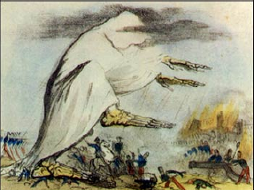
Models in Epidemiology
Sickness caused by an imbalance in the four humors (Hippocrates)
Miasmatic theory of disease (1500s)
Sickness results from emanations of ‘bad air’

Slide 27
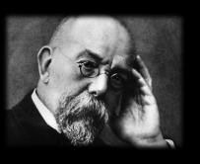
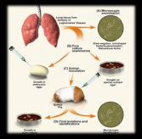
Models in Epidemiology
Sickness caused by an imbalance in the four humors (Hippocrates)
Miasmatic theory of disease (1500s)
Sickness results from emanations of ‘bad air’
Germ theory of disease
Leeuwenhoek’s microscope (1675)
Koch’s postulates (1890)

Slide 28
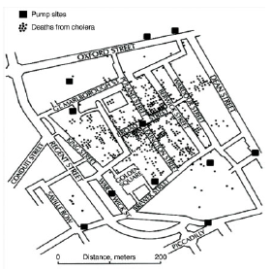
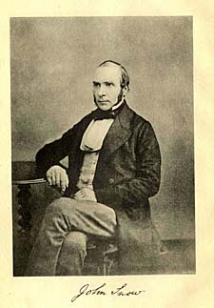
Models in Epidemiology
Sickness caused by an imbalance in the four humors (Hippocrates)
Miasmatic theory of disease (1500s)
Sickness results from emanations of ‘bad air’
Germ theory of disease
Leeuwenhoek’s microscope (1675)
Koch’s postulates (1890)
Classical epidemiology
John Snow and London cholera (1854)

Slide 29
Models in Epidemiology
Sickness caused by an imbalance in the four humors (Hippocrates)
Miasmatic theory of disease (1500s)
Sickness results from emanations of ‘bad air’
Germ theory of disease
Leeuwenhoek’s microscope (1675)
Koch’s postulates (1890)
Classical epidemiology
John Snow and London cholera (1854)
Mathematical epidemiology
Kermack and McKendrik (1927)
γ
S
βI or
βI/N
I
R
Susceptible
Infectious
Recovered

Slide 30
What is Ecology?
The study of the interactions of organisms and their environment
Coined in 1866 by German scientist Ernst Haeckel
Nile crocodiles opening mouths for sandpipers (Herodotus)
Emphasis on explaining dynamical processes in nature

Slide 31
Models in Ecology
Origins in plant biology and succession
Clements and Gleason (1910s-20s)

Slide 32
Models in Ecology
Origins in plant biology and succession
Clements and Gleason (1910s-20s)
Food Chains
- Charles Elton (1920s)

Slide 33
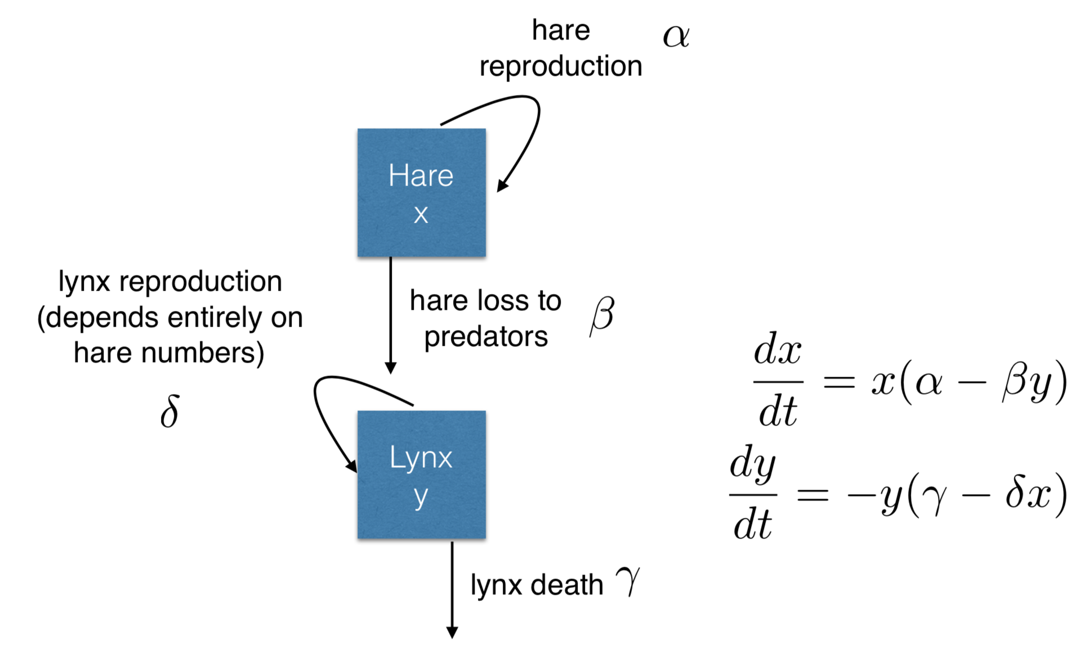
Models in Ecology
Origins in plant biology and succession
Clements and Gleason (1910s-20s)
Food Chains
- Charles Elton (1920s)
Predator-Prey Dynamics
- Lotka-Voltera (1920s)

Slide 34
Models in Ecology
Origins in plant biology and succession
Clements and Gleason (1910s-20s)
Food Chains
- Charles Elton (1920s)
Predator-Prey Dynamics
- Lotka-Voltera (1920s)
Mathematical Ecology
Robert MacArthur (1950s)
Island biogeography

Slide 35
Models in Ecology
Origins in plant biology and succession
Clements and Gleason (1910s-20s)
Food Chains
- Charles Elton (1920s)
Predator-Prey Dynamics
- Lotka-Voltera (1920s)
Mathematical Ecology
Robert MacArthur (1950s)
Island biogeography
Disease Ecology
Anderson and May (1980s)
Island biogeography
γ
S
βI or
βI/N
I
R
Susceptible
Infectious
Recovered

Slide 36
Misaotra!

